Slide 1
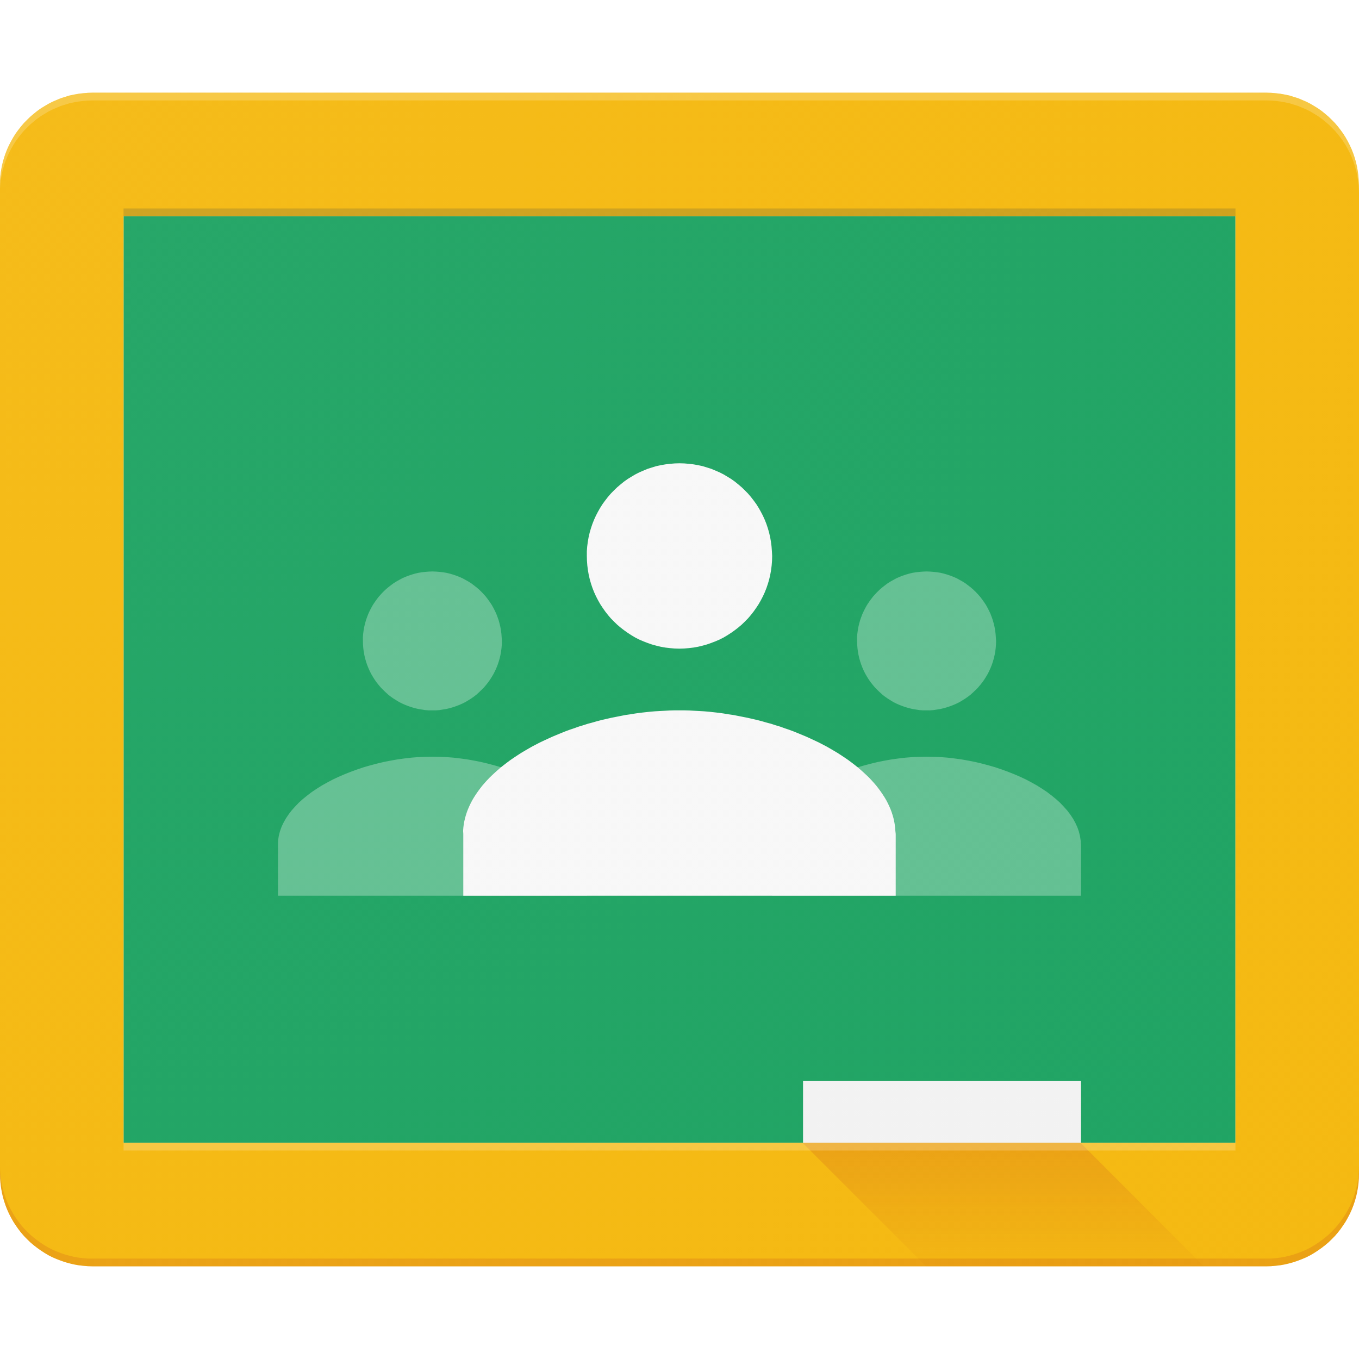
Google Classroom
Corey Tyler, Technology Director

Slide 2
Session Objectives
What is Google Classroom?
Google classroom is a Learning Management System that allows Teachers to create and manage their students classwork and assignments in order to conduct class either in person or virtually. Teachers can even differentiate instruction, assign grades, and give feedback while having one combined space to work.
The attendee will be able to create a new class in Google classroom in order to invite students and continue the learning process.
Teachers will be able to navigate the data stream to post announcements, assignments and quizzes in order to produce student grades for knowledge and content mastery.

Slide 3
Session Agenda
Key Points
We will get a basic introduction to Google Classroom
Take a look at some to the features in Google Classroom.
We will setup a google classroom.
We will add students.
We will change the theme.
Discuss daily lessons and activities in Google Classroom.
Stream - This is where you communicate with your class (whole class, groups of students)
Post - You can post streams immediately or you can schedule a post for later.
Re-use Post - You can reuse previous post in order to save time.
Classwork - You can create assignments, use the topic organizing feature and reorder your page.
People - You can invite Co-Teachers if you like or add other students or place students in groups if you would like to work with a group only.

Slide 4
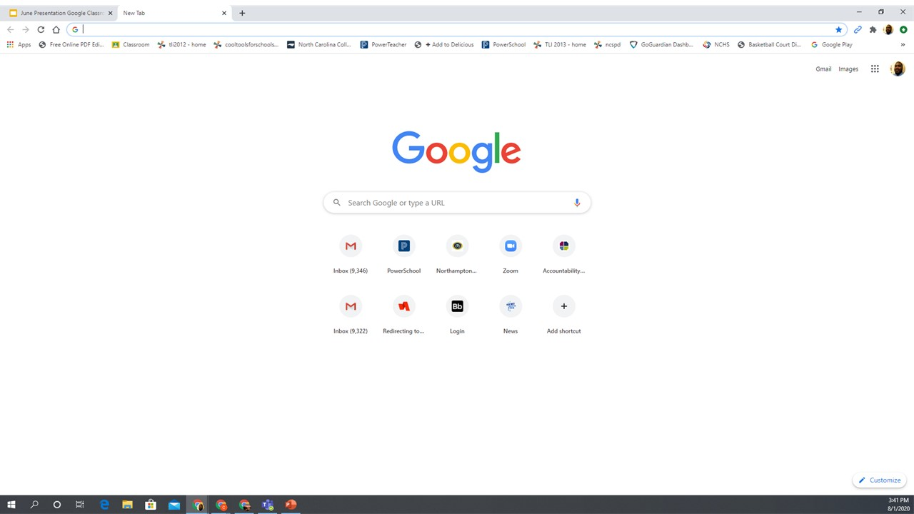
Sign in to Your Computer and go to Google’s Homepage

Slide 5
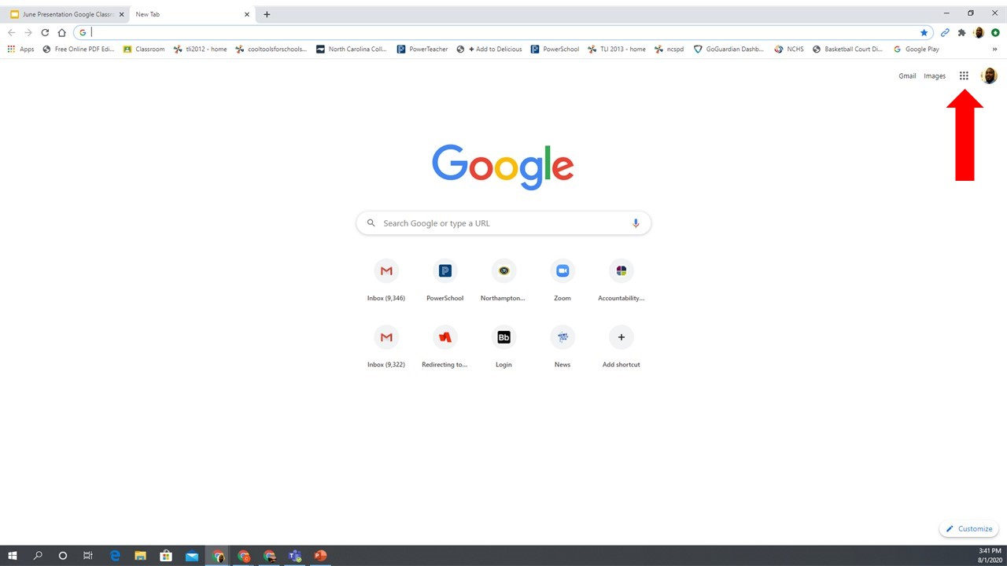
Click on the Waffle Boxes to access the pull down menu.

Slide 6
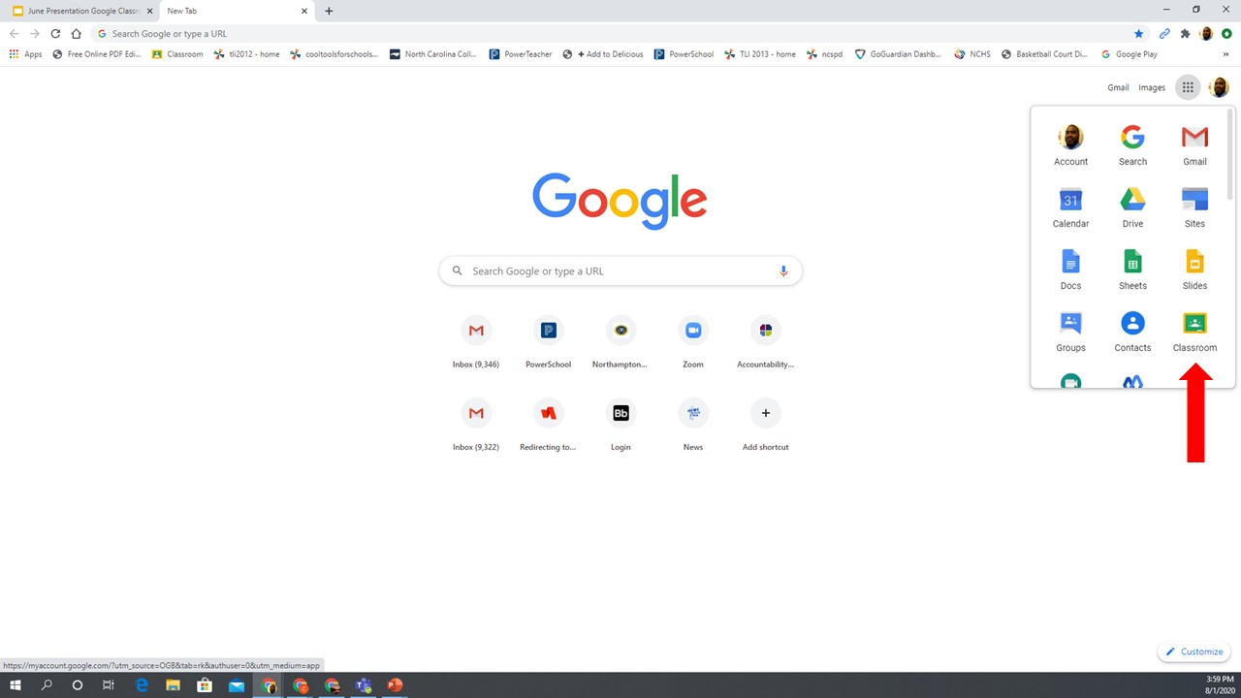
Click on the Google Classroom Icon to open Google Classroom.

Slide 7
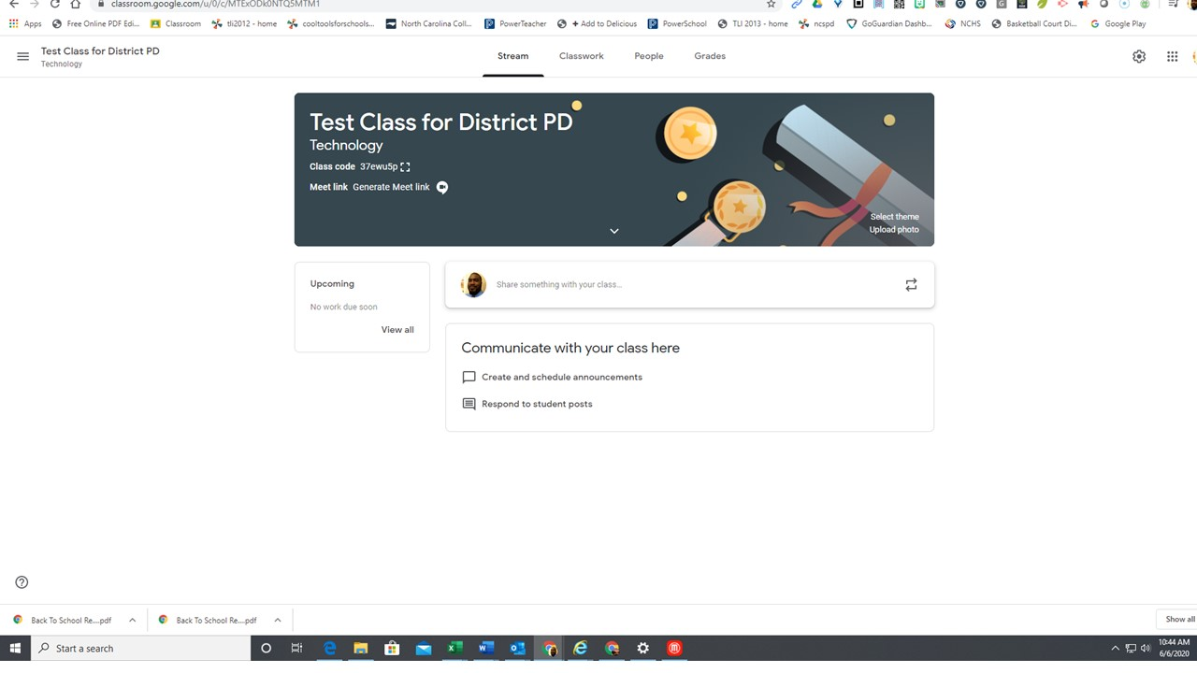
Let’s Get Started

Slide 8
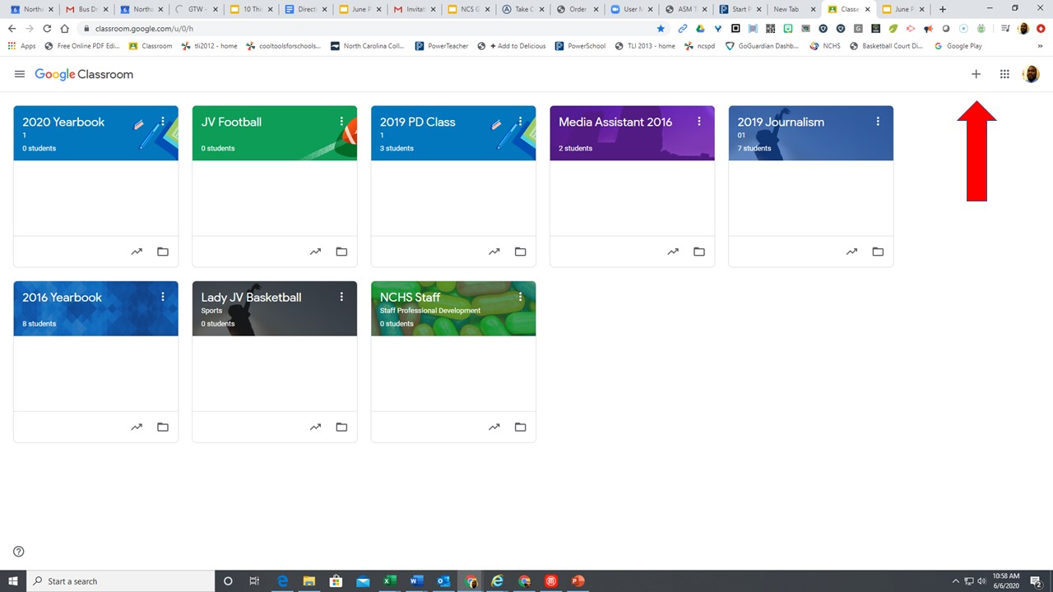

Slide 9
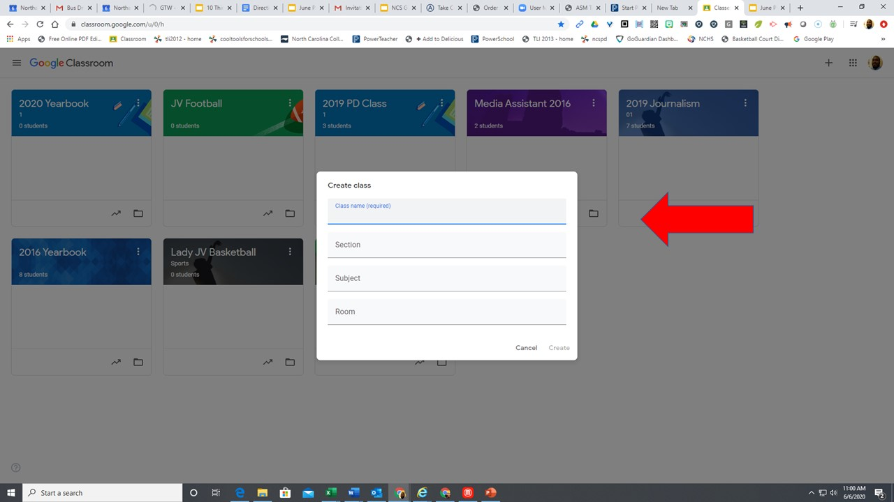

Slide 10
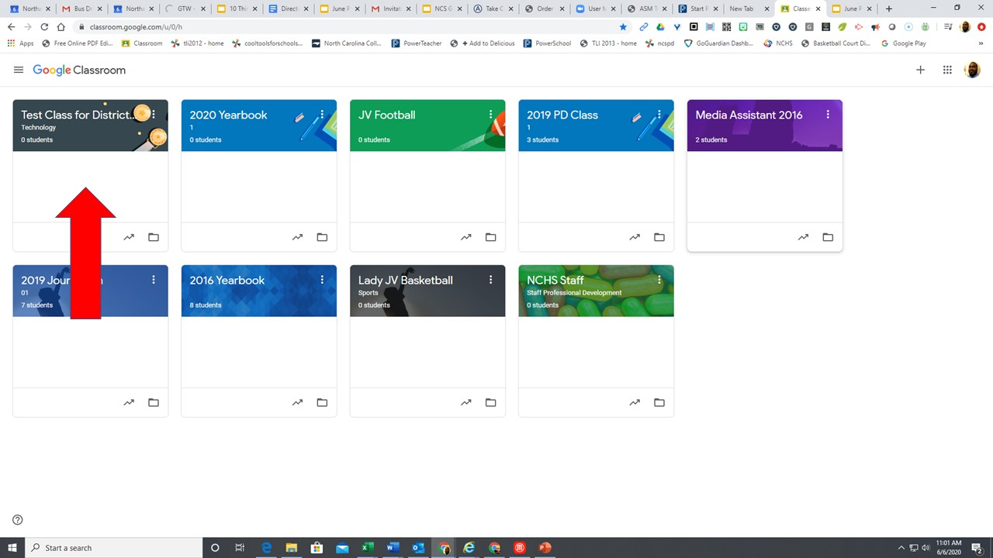

Slide 11
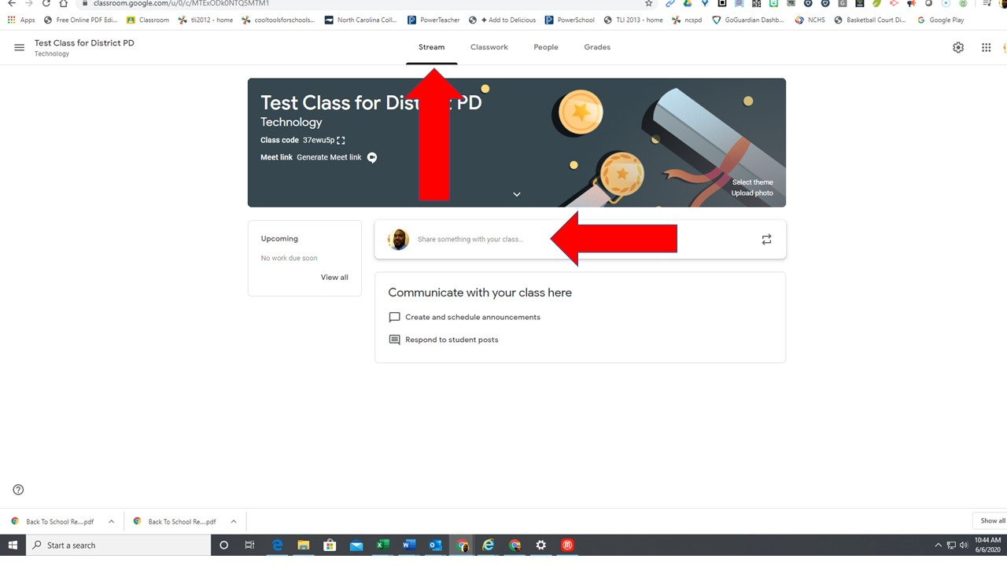

Slide 12
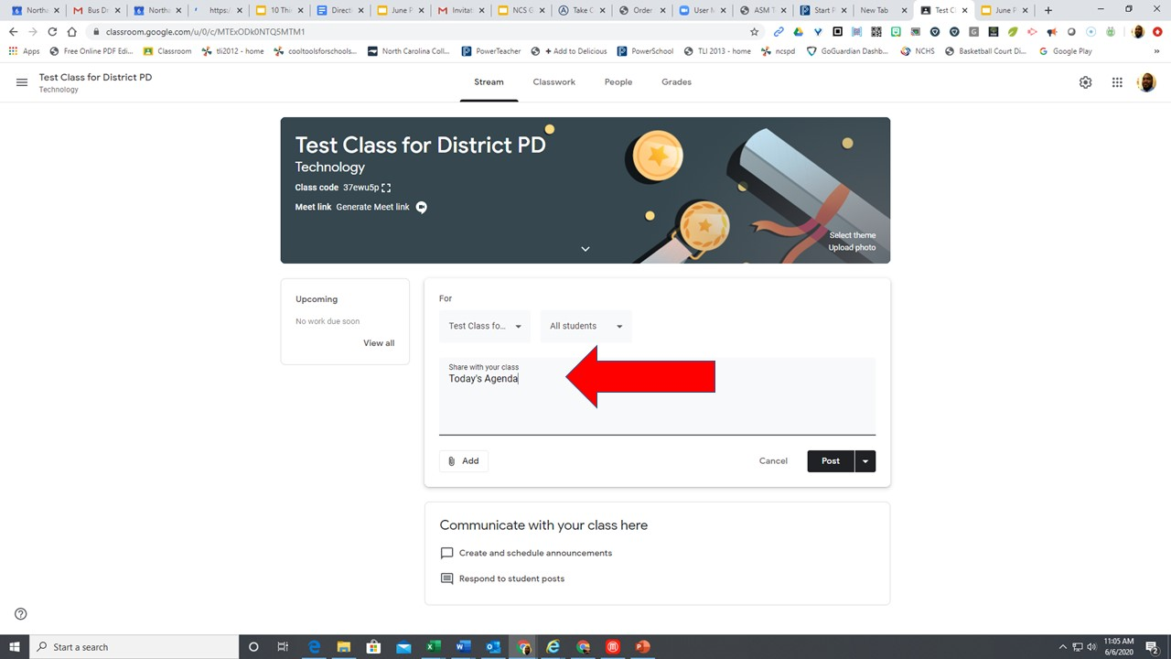

Slide 13
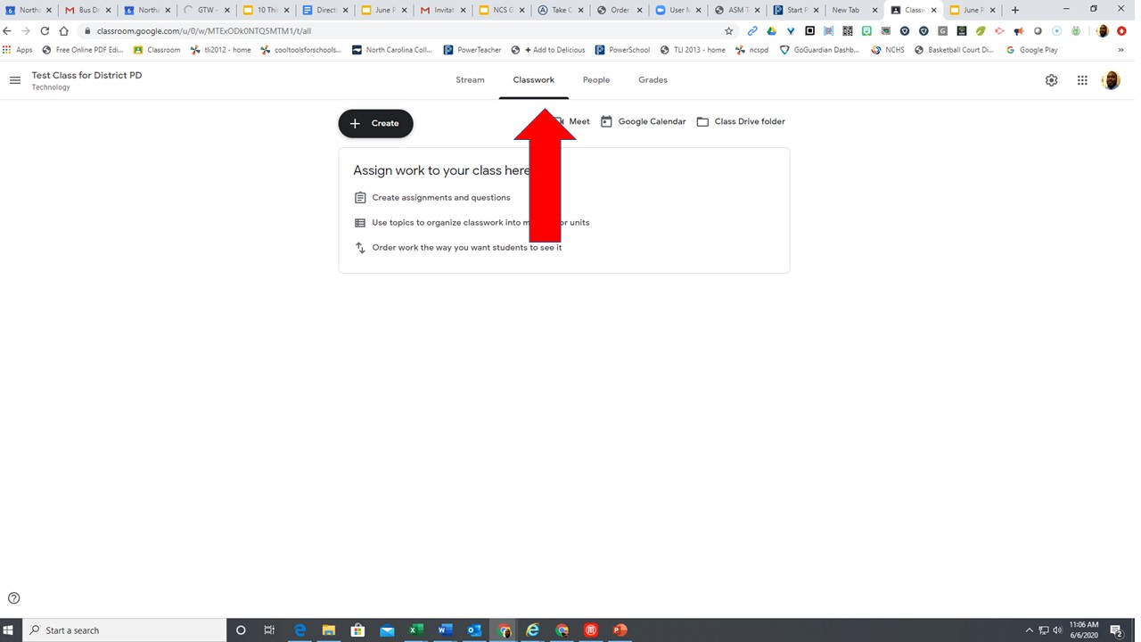

Slide 14
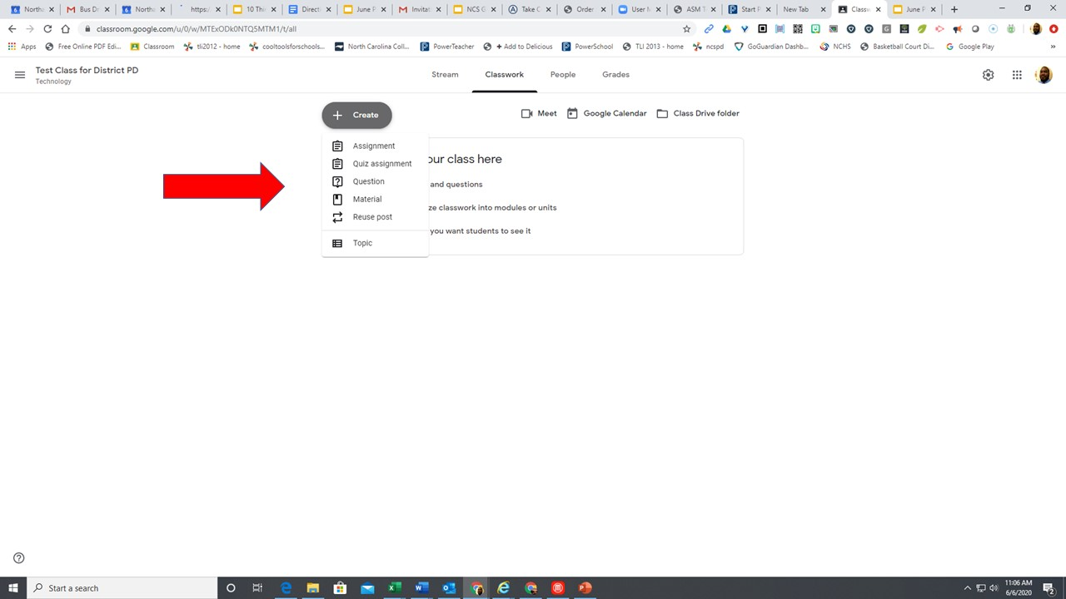

Slide 15
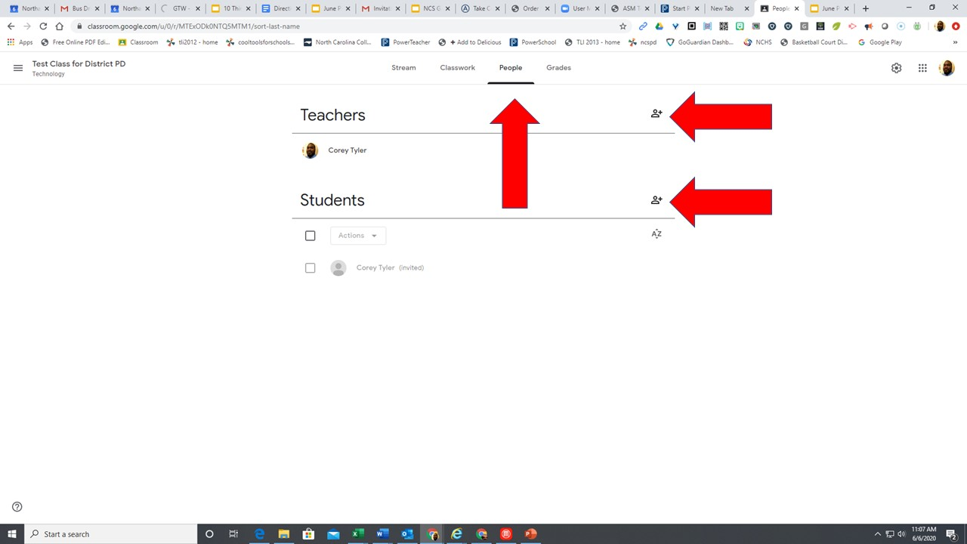

Slide 16
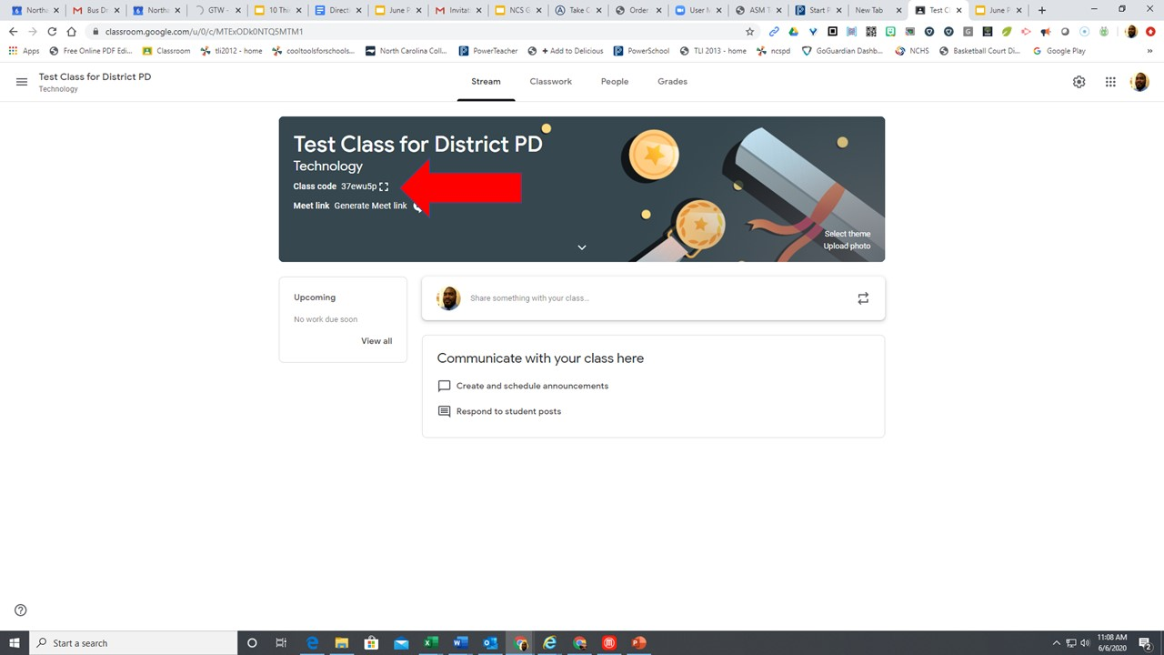

Slide 17
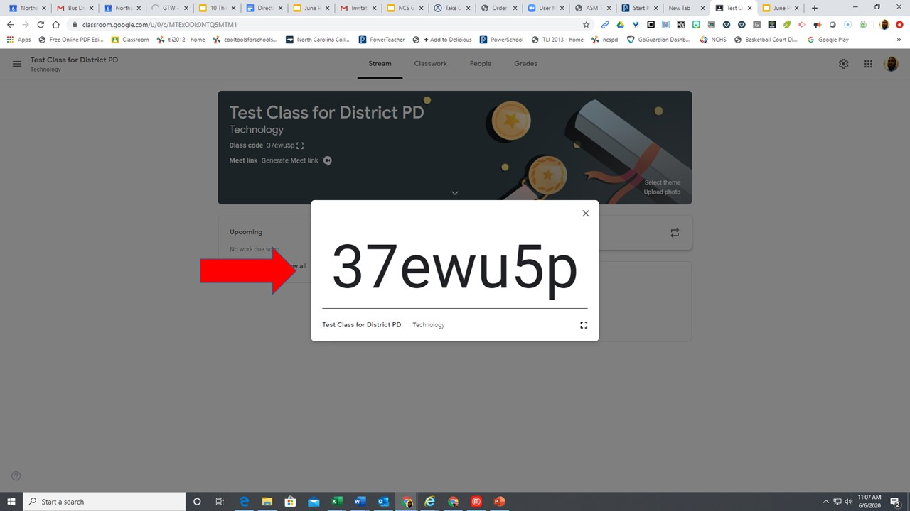

Slide 18
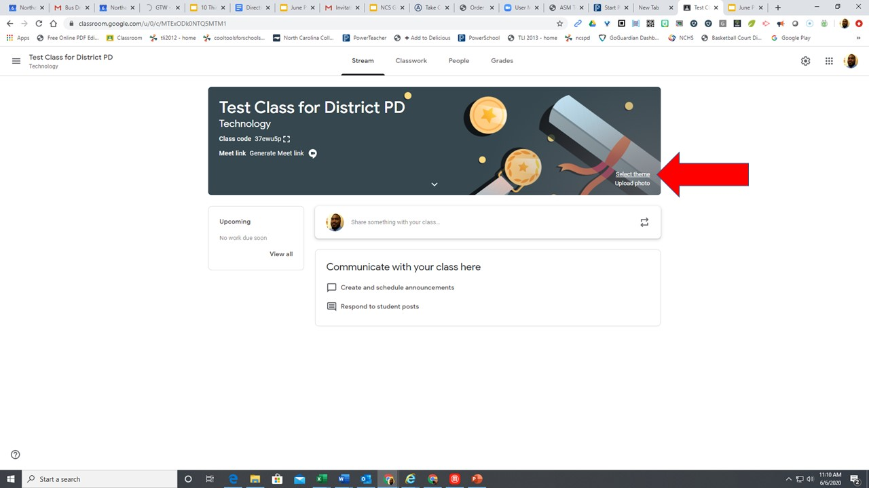

Slide 19
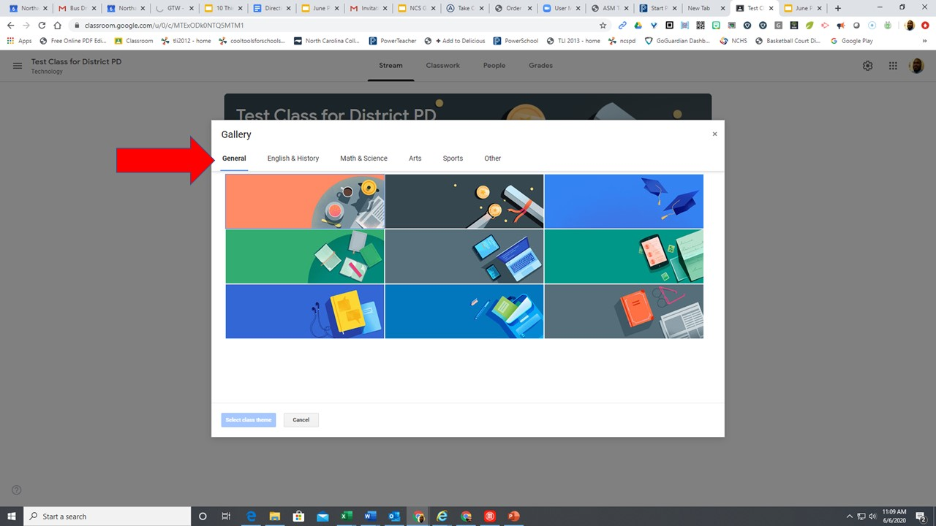

Slide 20
Let’s take a few moments to setup our own Google Classroom!

Slide 21
Questions, Answers and Concerns please email
tylerc@northampton.k12.nc.us
or call the Help Desk @
252-534-0222

